Slide 1
Chapter 2
QA Documentation Practices and Types
Presented By: SUBINA MAHARJAN

Slide 2
Topics
Understanding requirement
Division of modules
SRS Development
Project Timeline Document(Gantt Chart)
Release Note Document
Test case document
Wireframes
Project Closure Document

Slide 3
SRS(Software Requirement Specification) Doc
A software requirements specification (SRS) is a document that describes what the software will do and how it will be expected to perform.
It also describes the functionality the product needs to fulfill all stakeholders (business, users) needs.
These requirements can be functional as well as non-functional depending upon type of requirement.
The interaction between different customers and contractor is done because its necessary to fully understand needs of customers.

Slide 4
WHY SRS Doc
A software requirements specification is the basis for your entire project
It lays the framework that every team involved in development will follow.
It’s used to provide critical information to multiple teams — development, quality assurance, operations, and Client. This keeps everyone on the same page.
it can also help you make decisions about your product’s lifecycle
Writing an SRS can also minimize overall development time and costs

Slide 5
Understanding Requirement
It is essential to understand clearly the requirements in any project that you're about to undertake.
It's all too true that many projects have failed in the absence of well-defined project requirements.
The SRS fully describes what the software will do and how it will be expected to perform
SDLC/STLC

Slide 6
Modularization
Modularization is a technique to divide a software system into multiple discrete and independent modules, which are expected to be capable of carrying out task(s) independently.
A module is a software component or part of a program that contains one or more routines.
An enterprise-level software application may contain several different modules
Each module serves unique and separate business operations.

Slide 7
External link for more to SRS document
Types of Requirement and How to Analyse Requirements

Slide 8
SRS Document sample
Lets view the template

Slide 9
Gantt Chart Document
A Gantt chart is a graphical representation of activity against time.
A Gantt chart is a project management tool assisting in the planning and scheduling of projects of all sizes, although they are particularly useful for simplifying complex projects.
Gantt charts are useful for planning and scheduling projects.
They help you assess how long a project should take, determine the resources needed, and plan the order in which you'll complete tasks
They're also helpful for managing the dependencies between tasks.

Slide 10
Gantt Chart Document
Lets view the template

Slide 11
Release Note Document
Release notes are documents that are distributed with software products or hardware products, sometimes when the product is still in the development or test state (e.g., a beta release).
For products that have already been in use by clients, the release note is delivered to the customer when an update is released.
documents that are shared with end users, customers and clients of an organization.

Slide 12
How to write Release Note Doc
Start with the Title: Write down the title of the product and its version number (when necessary).
What’s New: This is common among all release notes. End users are always after new and added features.
Improvement and Fixes: If the product has previous versions, write down what was fixed and the new improvements.
Compatibility Issues: If the new version has been upgraded and requires new systems, do not forget to include it. It may be that the user’s system is incompatible with the upgraded version.

Slide 13
Release Note Document
Lets view the template
TEMPLATE

Slide 14
Test Case Document
A Test Case is a set of actions executed to verify a particular feature or functionality of your software application. A Test Case contains test steps, test data, precondition, postcondition developed for specific test scenario to verify any requirement.
Test Scenario Vs Test Case
Test scenarios are rather vague and cover a wide range of possibilities. Testing is all about being very specific.
For a Test Scenario: Check Login Functionality there many possible test cases are:
Test Case 1: Check results on entering valid User Id & Password
Test Case 2: Check results on entering Invalid User ID & Password
Test Case 3: Check response when a User ID is Empty & Login Button is pressed, and many more

Slide 15
Test Case Document
Lets view the template

Slide 16
Wireframes
A wireframe is a schematic, a blueprint, useful to help you and your programmers and designers think and communicate about the structure of the software or website you're building.
Why use wireframes?
The same screen can be built in a lot of different ways, but only a few of them will get your message across correctly and result in an easy-to-use software or website. Nailing down a good interface structure is possibly the most important part of designing software.

Slide 17
Wireframe cntd…
a document that outlines the structure of a website or app
A tool that clearly indicates what needs to be on every page.
establishes the relationship between everything on each page
Wireframing is a practice used by UX designers which allows them to define and plan the information hierarchy of their design for a website, app, or product.
Few best tools for wireframe are InVision, Miro, UXPin, Lucidchart etc

Slide 18
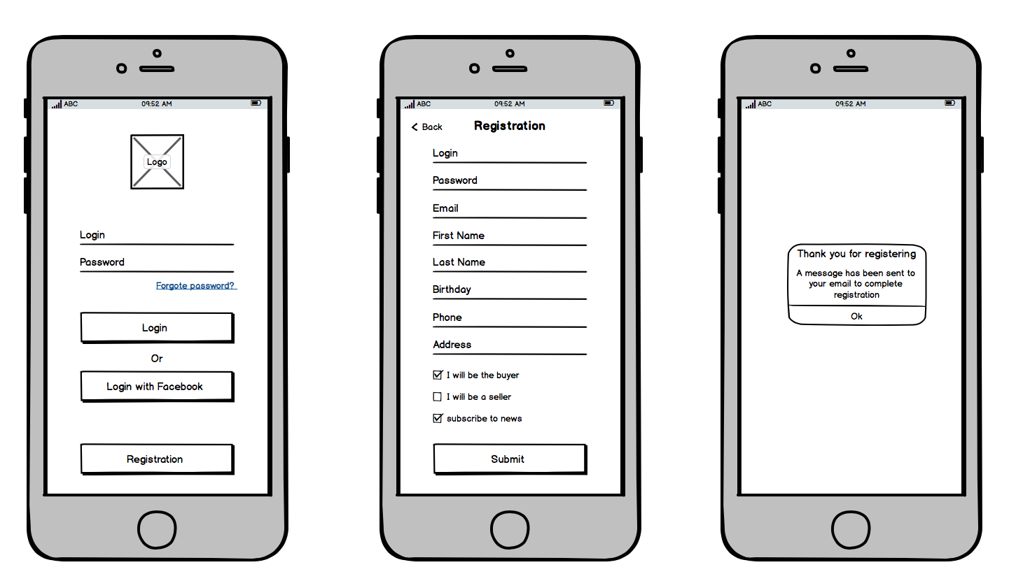
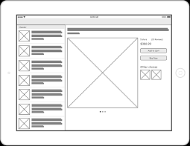
Wireframe Samples

Slide 19
Project Closure Document
The project closure report is the final project management deliverable for a project and is used for senior management to assess the success of the project.
The closure report records the final project sign off from the Sponsor, assesses success, and initiates a number of activities: identify and share best practices for future projects, identify and assign items to be addressed (issues, future initiatives, future projects), appropriately close current contracts, provide final project communication to stakeholders, release project resources, and ensure appropriate operational transition.
The closure report is part of the Portfolio Management Group’

Slide 20
Project Closure Document Template
Let’s view the Template

Slide 21
Thank you

